Slide 1

Linux Fundamentals VERSION 3 Part 4 Eng Ali Mohammad. Bani Bakkar

Slide 2
Filters

Slide 3
grep
The grep is to filter lines of text containing (or not containing) a certain string.
$ cat tennis.txt
Amelie Mauresmo, Fra
Kim Clijsters, BEL
Justine Henin, Bel
Serena Williams, usa
Venus Williams, USA
$ cat tennis.txt | grep Williams
Serena Williams, usa
Venus Williams, USA

Slide 4
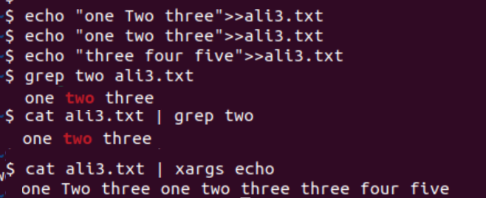
Example
Important
Cat filename | grep –i “flag” (security tasks)
Cat filename | grep –i “root\|password\|login” (security tasks)

Slide 5
Grep cont.
You can write this without the cat.
$ grep Williams tennis.txt
Serena Williams, usa
Venus Williams, USA
grep -i filters in a case insensitive way.
$ grep ali tennis.txt
Justine Henin, Bel
$ grep -i ali tennis.txt
filters
183
Kim Clijsters, BEL
Justine Henin, Bel
grep -v outputs lines not matching the string.
$ grep -v Fra tennis.txt
Kim Clijsters, BEL
Justine Henin, ali
Serena Williams, usa
Venus Williams, USA

Slide 6
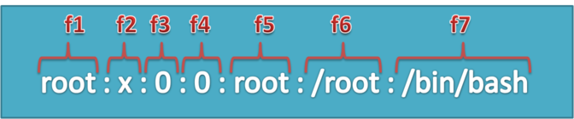
cut
The cut filter can select columns from files, depending on a delimiter or a count of bytes.
Use cut to filter for the username and userid in the /etc/passwd file.
It uses the colon as a delimiter, and selects fields 1 and 3.
$ cut -d: -f1,3 /etc/passwd | tail -4
Figo:510
Pfaff:511
Harry:516
Hermione:517
When using a space as the delimiter for cut, you have to quote the space.
$ cut -d" " -f1 tennis.txt
Amelie
Kim
Justine
Serena
Venus

Slide 7
tr
You can translate characters with tr.
$ cat tennis.txt | tr 'e' 'E'
AmEliE MaurEsmo, Fra
Kim ClijstErs, BEL
JustinE HEnin, BEl
SErEna Williams, usa
VEnus Williams, USA
Here we set all letters to uppercase by defining two ranges.
$ cat tennis.txt | tr 'a-z' 'A-Z'
AMELIE MAURESMO, FRA
KIM CLIJSTERS, BEL
JUSTINE HENIN, BEL
SERENA WILLIAMS, USA
VENUS WILLIAMS, USA

Slide 8
wc
Counting words, lines and characters is easy with wc.
$ wc tennis.txt
5 15 100 tennis.txt
$ wc -l tennis.txt
5 tennis.txt
$ wc -w tennis.txt
15 tennis.txt
$ wc -c tennis.txt
100 tennis.txt

Slide 9
uniq
With uniq you can remove duplicates from a sorted list.
$ cat music.txt
Queen
Brel
Queen
Abba
$ sort music.txt
Abba
Brel
Queen
Queen
$ sort music.txt |uniq
Abba
Brel
Queen
uniq can also count occurrences with the -c option.
$ sort music.txt |uniq -c
1 Abba
1 Brel
2 Queen

Slide 10
od
uses od to show the contents of the file in hexadecimal bytes
$ cat > text.txt
abcdefg
1234567
$ od -x text.txt
0000000 61 62 63 64 65 66 67 0a 31 32 33 34 35 36 37 0a
0000020
The same file can also be displayed in octal bytes.
$ od -b text.txt
0000000 141 142 143 144 145 146 147 012 061 062 063 064 065 066 067 0120000020

Slide 11
pipe examples
who | wc
How many users are logged on to this system ?
$ who
root tty1 Jul 25 10:50
paul pts/0 Jul 25 09:29 (laika)
Harry pts/1 Jul 25 12:26 (barry)
paul pts/2 Jul 25 12:26 (pasha)
$ who | wc -l
4
Display a sorted list of logged on users.
$ who | cut -d' ' -f1 | sort
Harry
paul
paul
root

Slide 12
pipe examples
Display a sorted list of logged on users, but every user only once .
$ who | cut -d' ' -f1 | sort | uniq
Harry
paul
root
grep | cut
Display a list of all bash user accounts on this computer.
$ grep bash /etc/passwd
root:x:0:0:root:/root:/bin/bash
paul:x:1000:1000:paul,,,:/home/paul:/bin/bash
serena:x:1001:1001::/home/serena:/bin/bash
$ grep bash /etc/passwd | cut -d: -f1
root
paul
Serena
display the users of /etc/
cut -d: -f1 /etc/passwd | column

Slide 13
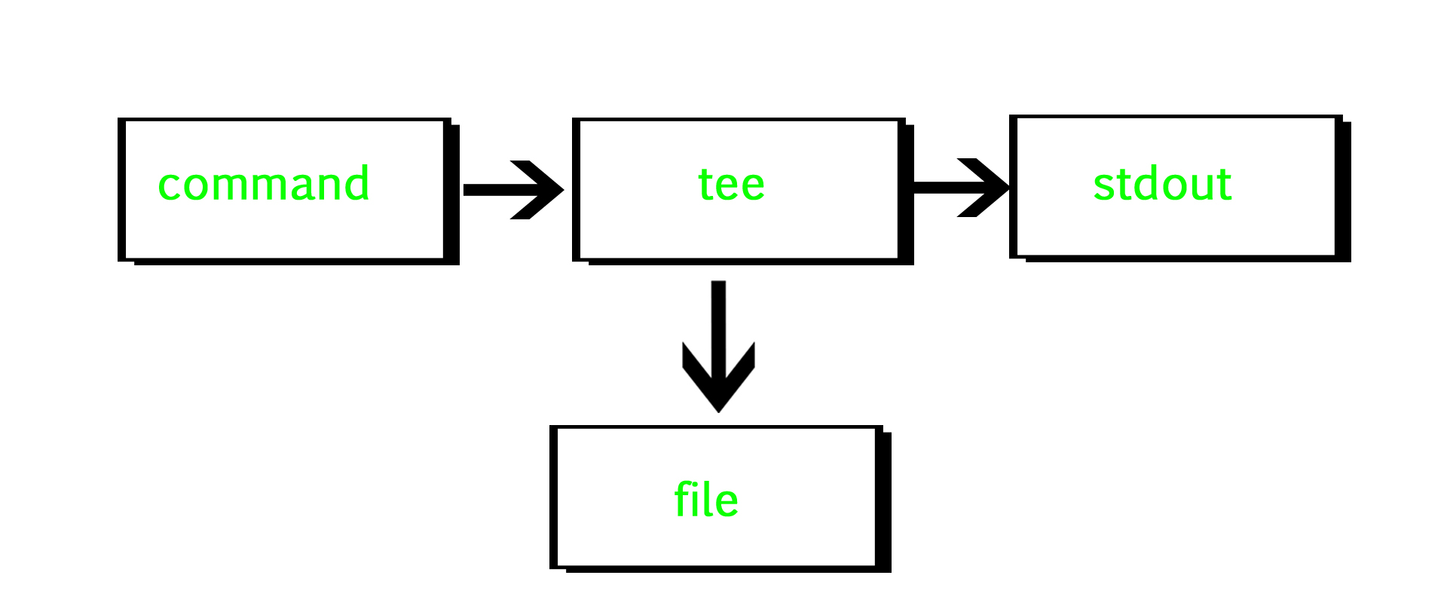
Tee

Slide 14
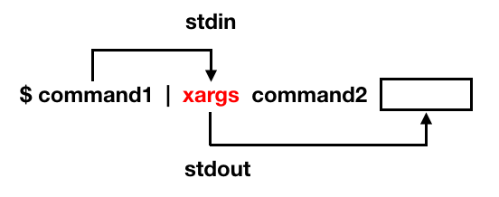
Tee , xarg
wc -l file1.txt| tee file2.txt
echo 'one two three' | xargs mkdir ls one two three

Slide 15
Linux Text Editors

Slide 16
Gedit
This is a general purpose GUI based text editor and is installed by default text editor on Gnome desktop environment. It is simple to use, highly pluggable and a powerful editor with the following features:
Support for UTF-8
Use of configurable font size and colors
Highly customizable syntax highlighting
Undo and redo functionalities
Reverting of files
Remote editing of files
Search and replace text
Clipboard support functionalities and many more

Slide 17
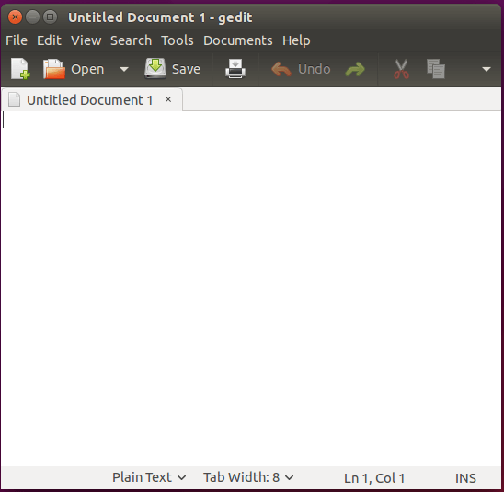

Slide 18
Nano Editor
Nano is an easy to use text editor especially for both new and advanced Linux users. It enhances usability by providing customizable key binding.
Nano has the following features:
Highly customizable key bindings
Syntax highlighting
Undo and redo options
Full line display on the standard output
Pager support to read form standard input

Slide 19
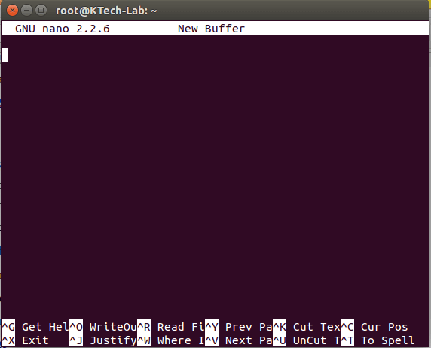

Slide 20
GNU Emacs
This is a highly extensible and customizable text editor that also offers interpretation of the Lisp programming language at its core. Different extensions can be added to support text editing functionalities.
Emacs has the following features:
User documentation and tutorials
Syntax highlighting using colors even for plain text.
Unicode supports many natural languages.
Various extension including mail and news, debugger interface, calender and many more

Slide 21
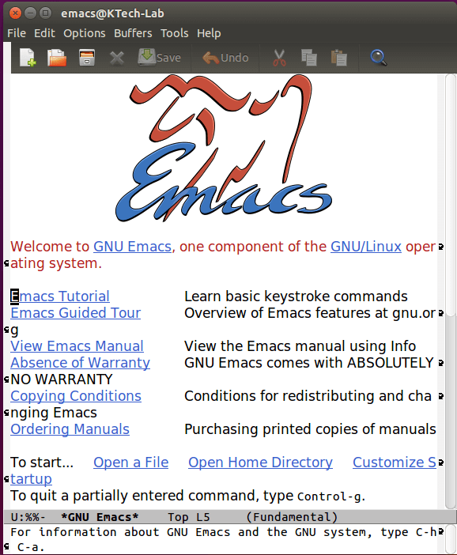

Slide 22
Kate/Kwrite
Kate is a feature rich and highly pluggable text editor that comes with KDesktop Environment (KDE). The Kate project aims at development of two main products that is: KatePart and Kate.
KatePart is an advanced text editor component included in many KDE applications which may require users to edit text whereas Kate is an multiple document interface(MDI) text editor.
The following are some of its general features:
Extensible through scripting
Encoding support such as unicode mode
Text rendering in bi-directional mode
Line ending support with auto detection functionalities
Also remote file editing and many other features including advanced editor features, applications features, programming features, text highlighting features, backup features and search and replace features.

Slide 23
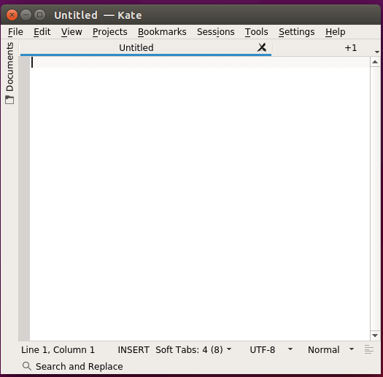

Slide 24
Lime Text
This is a powerful IDE-like text editor which is free and open-source successor of popular Sublime Text. It has a few frontends such as command-line interface that you can use with the pluggable backend.

Slide 25
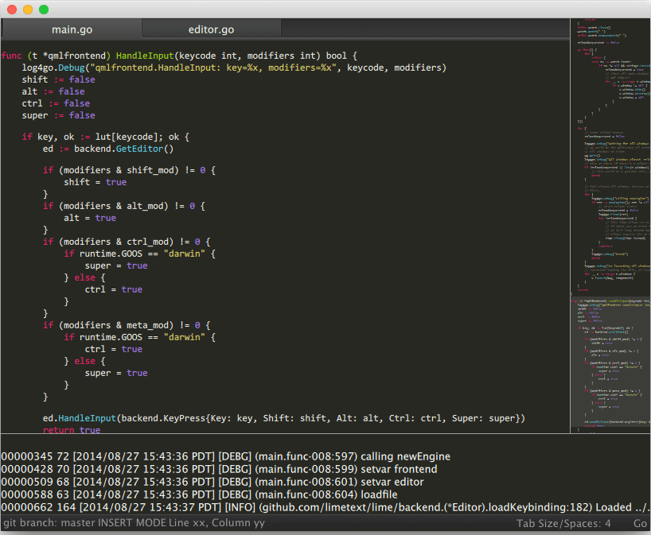

Slide 26
Jed Editor
This is also another command line editor with support for GUI like features such as dropdown menus. It is developed purposely for software development and one of its important features is support of unicode mode.

Slide 27
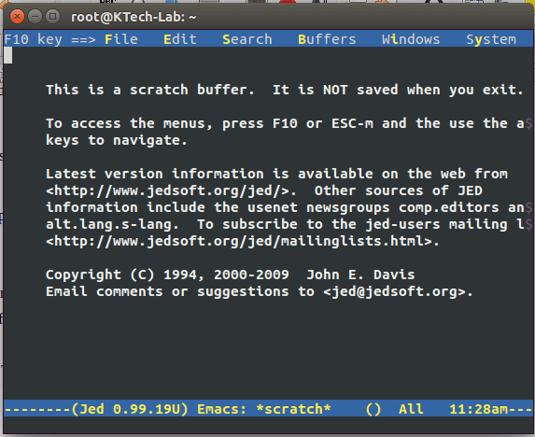

Slide 28
gVim Editor
It is a GUI version of the popular Vim editor and it has similar functionalities as the command line Vim.

Slide 29
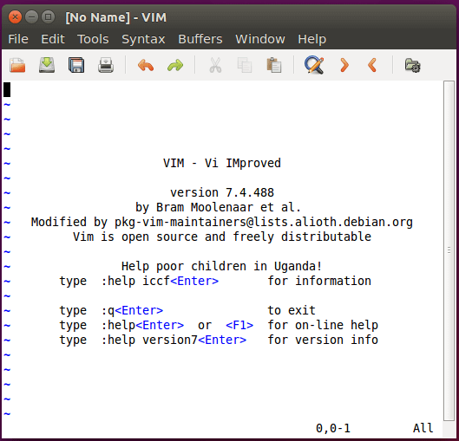

Slide 30
also
Geany Editor
Leaf Pad
Bluefish
Atom
VSCode
Light Table
Medit Text Editor
Neovim – Vim-based Text Editor
etc

Slide 31
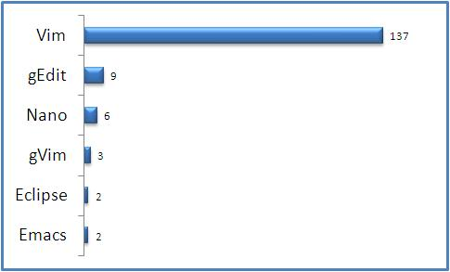
Favorite Linux Text Editor Voting Results

Slide 32
Vim
Vim is a powerful text editor used in CLI (command line interface).
Linux uses a lot of configuration files, you'll often need to edit them and vim is a great tool to do so.
Alternatives to vim are the commandline editors nano and joe.

Slide 33
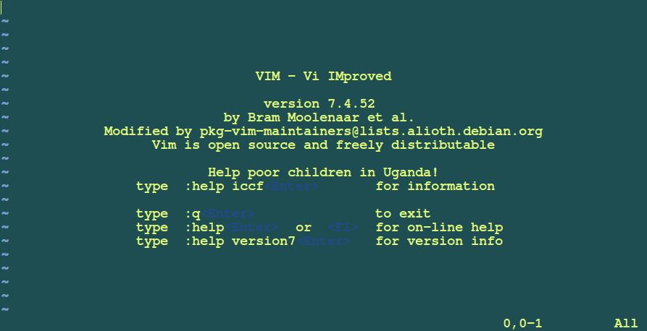

Slide 34
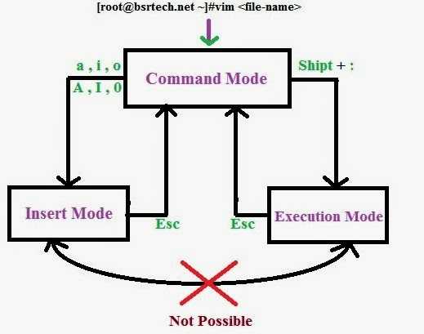

Slide 35
Vim Command Reference
save: :w save and exit: :wq exit: :q force: ! (example :w! :q!) documents. copy: y copy a line: yy paste: p cut: d cut a line: dd
Set number

Slide 36
Vim Command Reference
command action
x delete the character below the cursor
X delete the character before the cursor
r replace the character below the cursor
p paste after the cursor (here the last deleted character)
xp switch two characters

Slide 37
Introduction to Users management

Slide 38
User types
Root user
Service user
Normal user
What is the importance for every type?

Slide 39
commands
whoami
The whoami command tells you your username.
who
The who command will give you information about who is logged on the system.
who am i
With who am i the who command will display only the line pointing to your current session.
w
The w command shows you who is logged on and what they are doing.
id
The id command will give you your user id, primary group id, and a list of the groups that you belong to.
Whereis

Slide 40
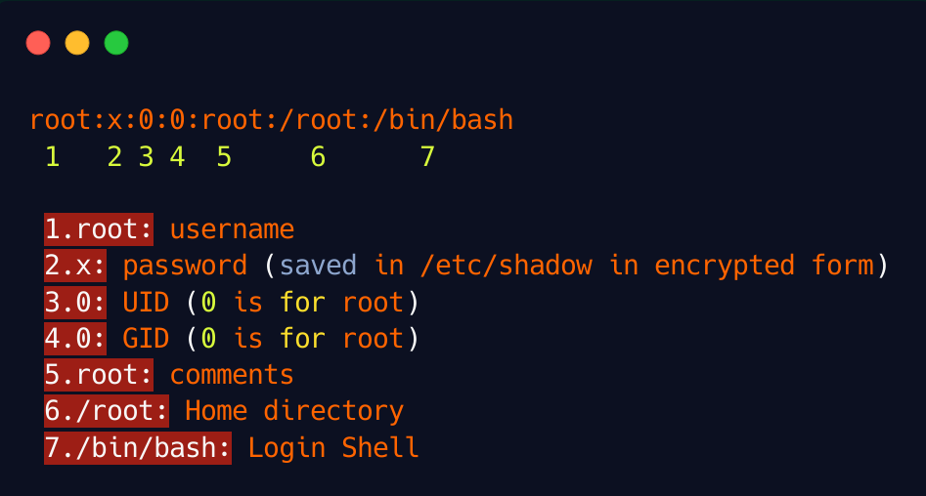
/etc/passwd

Slide 41
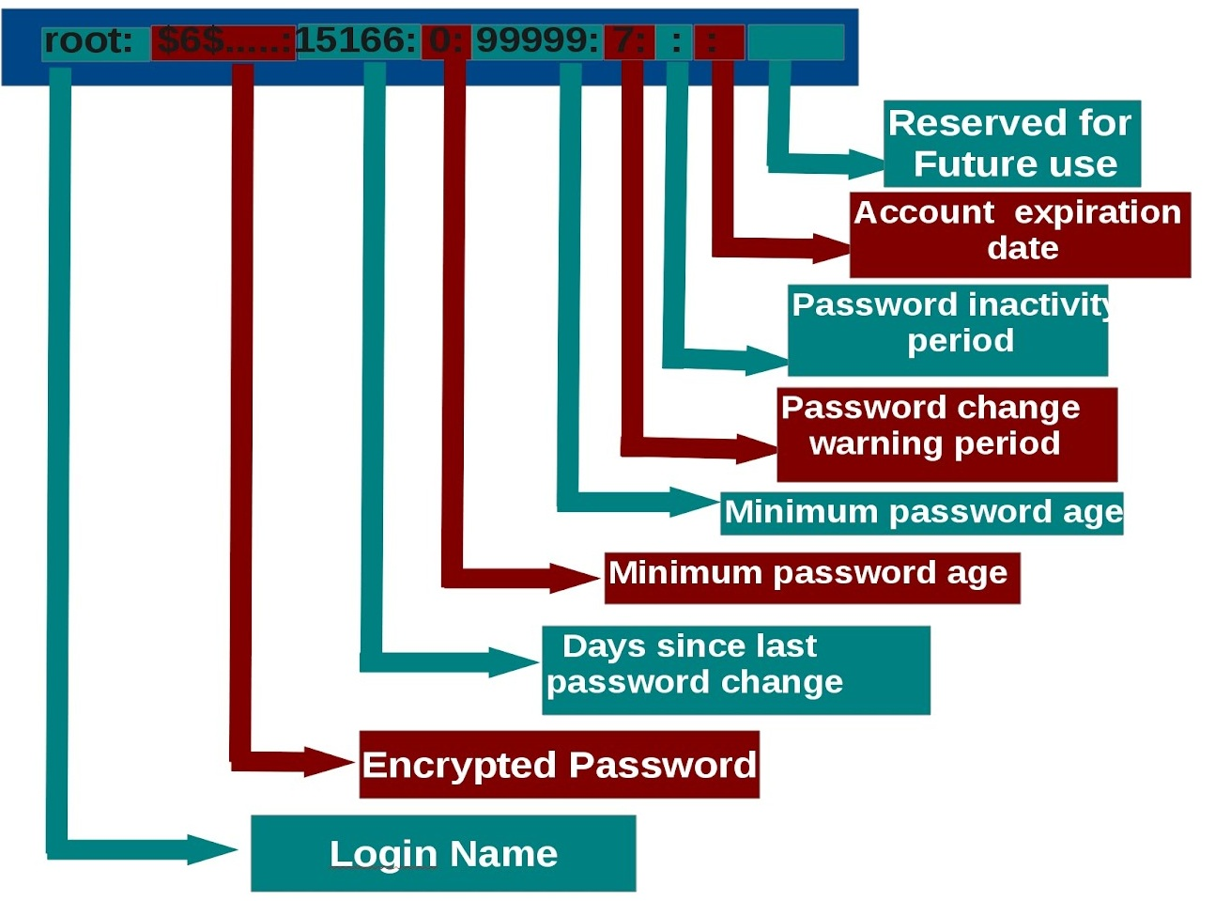
/etc/shadow

Slide 42
su to another user
The su command allows a user to run a shell as another user.
su - $username
By default, the su command maintains the same shell environment.

Slide 43
Useradd userdel
Useradd / adduser
-s : shell
-p :password
-u :user id
-c : gecos
-e :expiration date
-md : home directory
Use usermod to change the attributes of the user after creation
You can delete the user with userdel. The -r option of userdel will also remove the home directory.

Slide 44
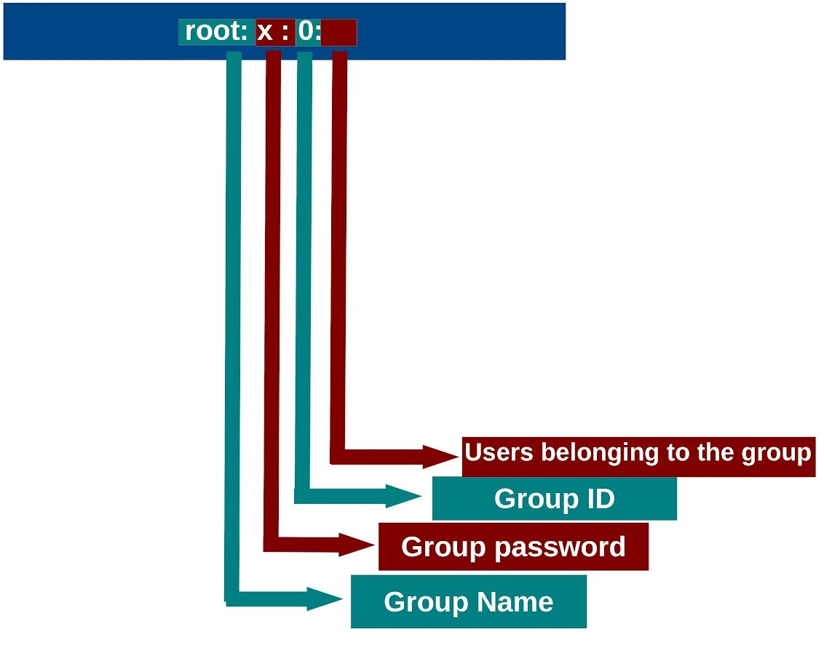
/etc/group

Slide 45
# useradd ali
# passwd ali
# useradd -G admin -u 1005 -s /usr/sbin/nologin ali
# useradd -c "ahmed " -e 2016-12-31 -s /bin/csh ahmed
To verify:
# id
# id ali
# id -u ali (UID for ali)
# tail -n 1 /etc/passwd
username:password:UID:GID:GECOS:/home/dir:shell
note:
# tail -n 1 /etc/shadow
name:password:1astchange:minage:maxage:warning:inactive:expire:b1ank
The number 1 indicates an MD5 hash. The number 6 appears when a SHA-512 hash is used.
# authconfig --passalgo=<descrypt|bigcrypt|md5|sha256|sha512> (to change the hashing type)
note:
!! indicates that the user has no password

Slide 46
Modify users:
#usermod -L ali (lock the user)
#usermod -U ali (unlock the user)
#usermod -G sales ali (overwrite secondary group)
#usermod -aG admin ali (append to secondary group)
or:
#vim /etc/group
To verify:
#id ali

Slide 47
Delete users:
#userdel ali
#userdel -r test (removes home directory)
Note:
useradd command assigns new users the first free UID number available in the range starting from UID 1000 or above.
[root@master ~]#useradd ali
#ls /home/ -l
drwx------. 5 ali ali 4096 Jun 21 21:36 ali
[root@master ~]#userdel ali
[root@master ~]#useradd ahmed
#ls /home/ -l
drwx------. 5 ahmed ahmed 74 Jun 23 05:00 ali
drwx------. 3 ahmed ahmed 74 Jun 23 02:55 ahmed

Slide 48
Groupadd
-g :primary group id
-G : secondary group id
-aG: add secondary group
$useradd ali –G sales
TO ADD A USER TO A SECONDARY GROUP USE:
usermod -a -G examplegroup exampleusername

Slide 49
UID ranges:
UID 0 is always assigned to the superuser account, root.
UID 1-200 is a range of "system users" assigned statically to system processes by Red Hat.
UID 201-999 is a range of "system users" used by system processes that do not own files on the file system.
UID 1000+ is the range available for assignment to regular users.
To change the default:
#vim /etc/login.defs
==========================================================
Password aging:
#chage -l ali (list info about the user)
#chage -E 2017-1-1 ali (expire the user on the specified address)
#chage -m 1 ali (set minimum number of days before password change)
#chage -M 120 ali (set maximim number of days before password change)
#passwd -x 90 ali (the password will expire after 90 days)
==========================================================
Create a default file or directoy in the user's home directory:
#touch /etc/skel/new_file
==========================================================
GUI tool to manage users and groups:
#yum install system-config-users
#system-config-users

Slide 50
Primary group is the user Private Group (UPG).
# groupadd sales
# groupadd -g 1005 admin
To verify:
# id
# id ali
# grep sales /etc/group
groupname:password:GID:list,of,users,in,this,group
# groupmod -g 2000 admin
# groupadd old
# groupmod -n new old (rename a group)

Slide 51
run a program as another user
The sudo program allows a user to start a program with the credentials of another user.
Before this works, the system administrator has to set up the /etc/sudoers file. This can be useful to delegate administrative tasks to nother user (without giving the root password).

Slide 52
Running commands as root with sudo:
# vim /etc/sudoers
ali ALL=(ALL) ALL
%sales ALL=(ALL) ALL
$ sudo passwd ahmed
$ sudo passwd -l ahmed
To verify:
# tail -f /var/log/secure

Slide 53
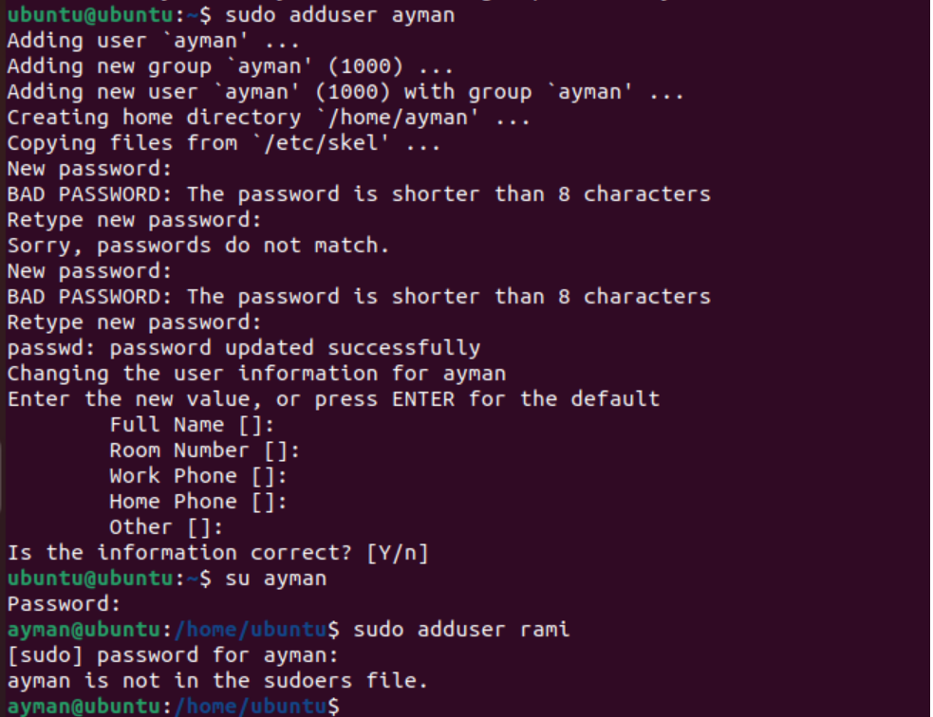

Slide 54
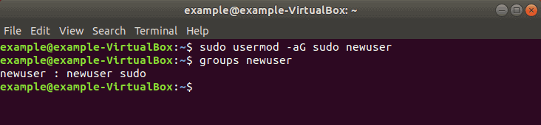

Slide 55
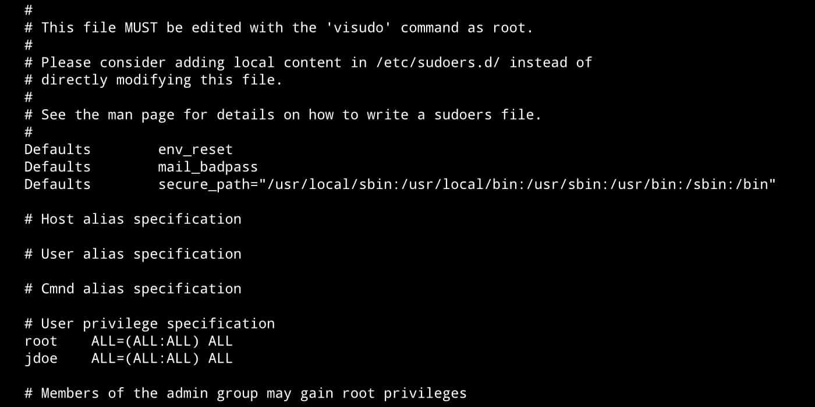

Slide 56
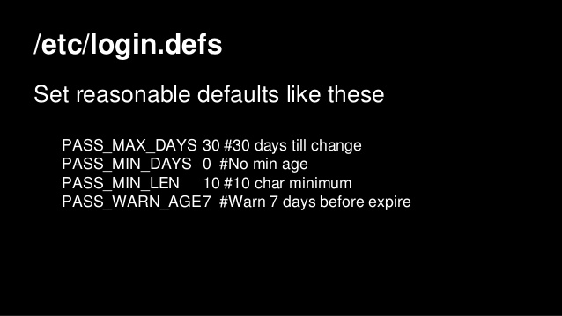
/etc/login.defs
The /etc/login.defs file contains some default settings for user passwords like password aging and length settings.

Slide 57
File Security

Slide 58
Standard File Permissions

Slide 59
Ownership of Linux files
Every file has a user owner and a group owner
Every file and directory on your Unix/Linux system is assigned 3 types of owner.
User
A user is the owner of the file. By default, the person who created a file becomes its owner. Hence, a user is also sometimes called an owner.
Group
A user- group can contain multiple users. All users belonging to a group will have the same access permissions to the file.
Other
Any other user who has access to a file. This person has neither created the file, nor he belongs to a usergroup who could own the file. Practically, it means everybody else.

Slide 60
Permissions
Read: This permission give you the authority to open and read a file. Read permission on a directory gives you the ability to lists its content.
Write: The write permission gives you the authority to modify the contents of a file. The write permission on a directory gives you the authority to add, remove and rename files stored in the directory.
Execute: you cannot run a program unless the execute permission is set.
A user must have execute access to the bin directory in order to execute the ls or the cd command.
Use Ls –l /home/ -d

Slide 61
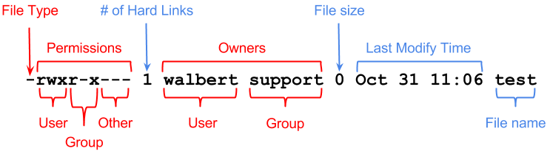

Slide 62
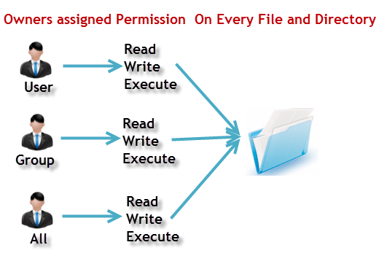

Slide 63
setting permissions (chmod)
Permissions can be changed with chmod. The first example gives the user owner execute permissions.
This example removes the group owners read permission.
$ chmod g-r permissions.txt
$ ls -l permissions.txt
This example removes the others read permission.
$ chmod o-r permissions.txt
This example gives all of them the write permission.
$ chmod a+w permissions.txt

Slide 64
setting permissions (chmod) cont.
You don't even have to type the a.
$ chmod +x permissions.txt
You can also set explicit permissions.
$ chmod u=rw permissions.txt
make any kind of combination.
$ chmod u=rw,g=rw,o=r permissions.txt
Even fishy combinations are accepted by chmod.
$ chmod u=rwx,ug+rw,o=r permissions.txt

Slide 65
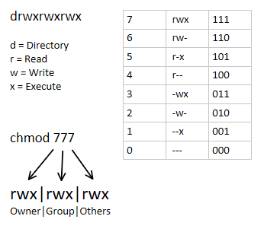
setting octal permissions

Slide 66
setting octal permissions cont.
This makes 777 equal to rwxrwxrwx and by the same logic, 654 mean rw-r-xr-- . The chmod
command will accept these numbers.
$ chmod 777 permissions.txt
$ chmod 664 permissions.txt
$ chmod 750 permissions.txt

Slide 67
umask
What is umask? umask, :User file creation mask which is used for determining the default permission for a new file creation. umask command is a shell built-in.
the default file creation value is 666, the default directory creation value is 777
Say, the umask value is 022(normal user). 002(root user)
Assume we create a file say "file1". The permissions given for this file will be the result coming from the substraction of the umask from the default value :
Default: 666 umask : 022 --------------- Result : 644 644 is the permission to be given on the file "file1“.

Slide 68
Umask cont.
How to find out the umask value? $ umask 0022 The option -S gives in more readable format. $ umask -S u=rwx,g=rx,o=rx This means umask, at the max, allows all permissions for the user, read and execute alone for the group and others. How to set the umask value? $ umask 033
How to set this umask permanently for a user? To set this value permanently for a user, it has to be put in the appropriate etc/profile file AND etc/bashrc which depends on the default shell of the user. Who can set the umask value? It can be set by the root user which will be applicable across the system. Also, a given user can override the umask value by having his own setting in his/her profile file.

Slide 69
chgrp and chown
chgrp
You can change the group owner of a file using the chgrp command.
# chgrp newgroup file
Chown
You can change the user owner of a file using the chown command.
# chown newuser File
You can also use chown to change both the user owner and the group owner.
# chown groupowner:userowner File

Slide 70
list of special files
- normal file
d directory
l symbolic link
p named pipe
b block device
c character device
s socket

